Slide 1
HOSPITAL MANAGEMENT SYSTEM
Course #cs5600
CRn #31465
PREPARED BY:
SIva bushan Boini 700663090
Naga Praneeth DuNNALA 700656346
Srikar Katta 700652735
Submitted to :
Prof. Sunae (Sunny) Shin
University of Central Missouri

Slide 2
1.Introduction and Background
Purpose
To perform automation of Hospital Management.
Scope
Can be used in any hospital, clinic, dispensary or pathology.
Labs for maintaining patient details and their test results.
It gives the details of doctors, staff and patients including
doctors appointments and the billing system.

Slide 3
1.Introduction and Background
A hospital management system, integrated information system designed to manage the administrative, financial clinical aspects of a hospital. This encompasses paper-based information processing as well as data processing machines.
Administration of the Hospitals daily business transactions (financial, personal, payroll, bed census etc.)
Evaluation of hospital performance and cost, projection of the long-term forecast.

Slide 4
1.Introduction and Background
A database is a separate application that stores a collection of data. Each database has one or more distinct APIs for creating, accessing, managing, searching and replicating the data it holds.
management systems (RDBMS) to store and manage huge volume of data. This is called relational database because all the data is stored into different tables and relations are established using primary keys or other keys known as Foreign Keys.
References:
IOSR Journal of Mobile Computing & Application (IOSR-JMCA) e-ISSN: 2394-0050, P-ISSN: 2394-0042.Volume 2, Issue 1. (Mar. - Apr. 2015), PP 32-36 www.iosrjournals.org
Praveen K.A and Gomes L.A, 2006: “A Study of the Hospital Information System (HIS) In the Medical Records Department of A Tertiary Teaching Hospital” Journal of the Academy of Hospital Administration, Vol. 18, No. 1 (2006-01 - 2006-12).

Slide 5
2.External Schema
The Doctor patient managing system that assists the doctors in their work and also patients with booking physical checkups and view medicinal advance. The system permits doctors to deal with their booking appointments. Patients are allowed to book their appointment slots on the web and those booked spaces are held in their name.
The next time when a patient login to his account he can view his medical records. The doctor can view the patient record whenever he want to access it even when the patient did not booked the appointment.
LOGIN : This allows the Doctor/Patient to login and manage the bookings and helps in viewing the medical reports.
BOOK APPOINTMENT : This allows patients to book the slots online and reserve in their name, so that they can consult the doctor and system manages the appointment dates and times for various doctors.

Slide 6
2.External Schema
CHECK BOOKINGS :
This allows the patients to check the bookings made by them by displaying the Doctors information and the Remarks made by the Doctor.
VIEW APPOINTMENTS:
This allows the Doctor to view the appointments made by the patients with their required time, and respond to the appointment.

Slide 7
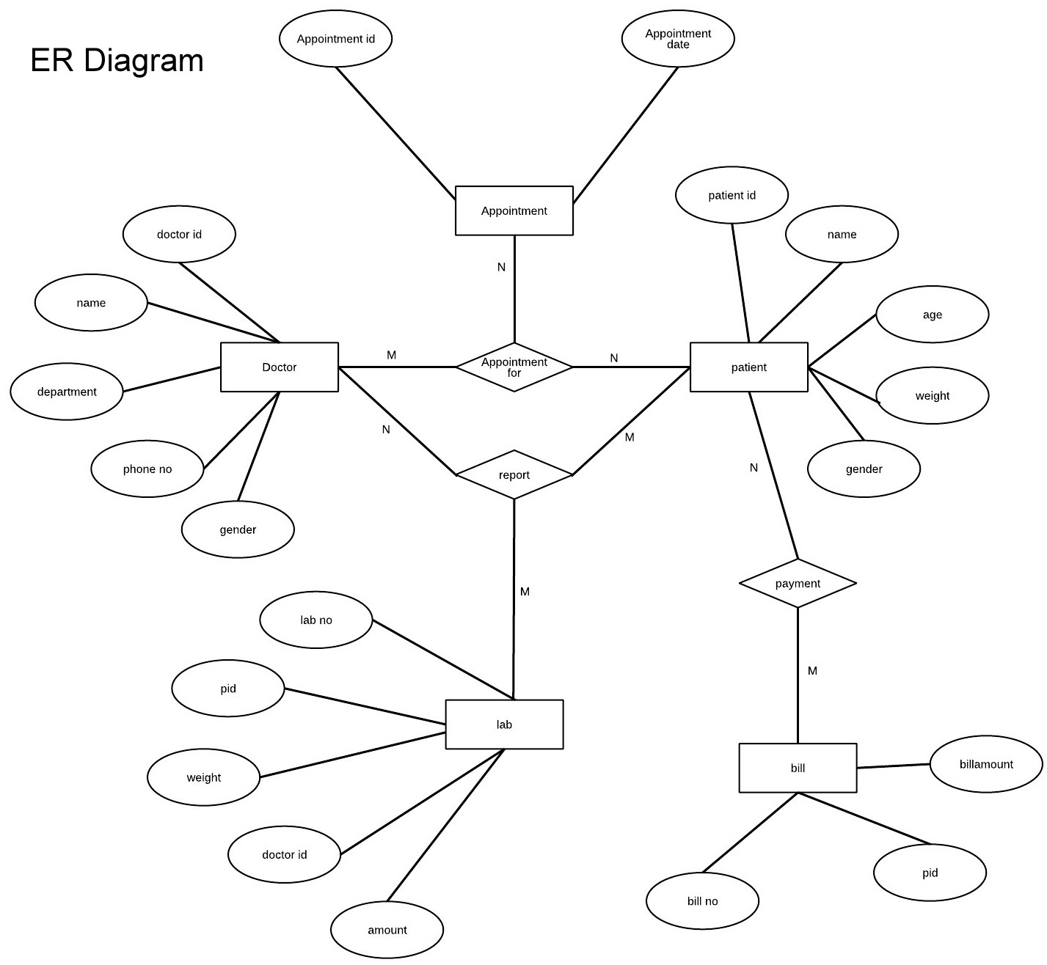
3. ER Diagram

Slide 8
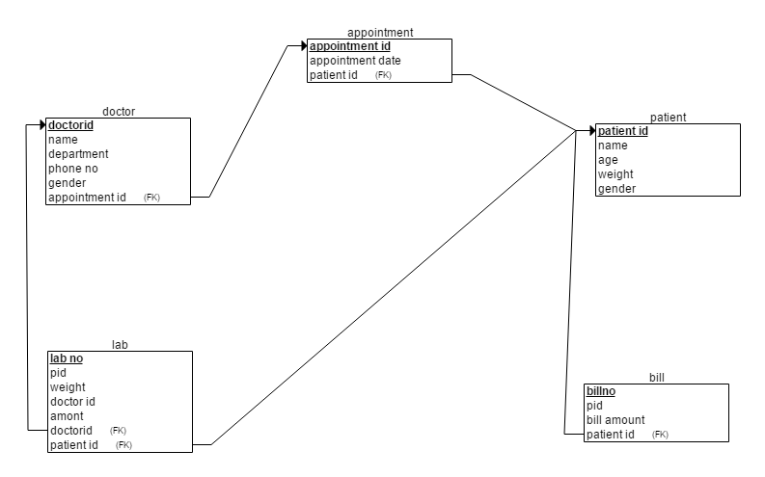
4.Relational Model

Slide 9
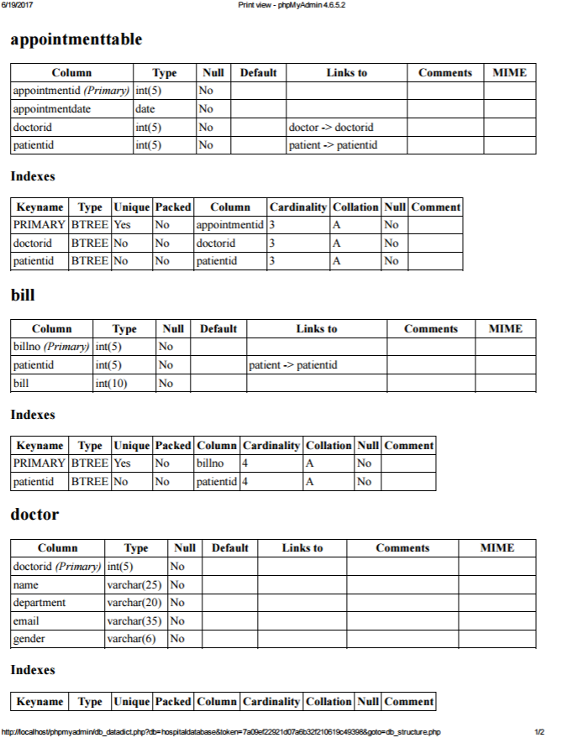
5.Data Dictionary

Slide 10
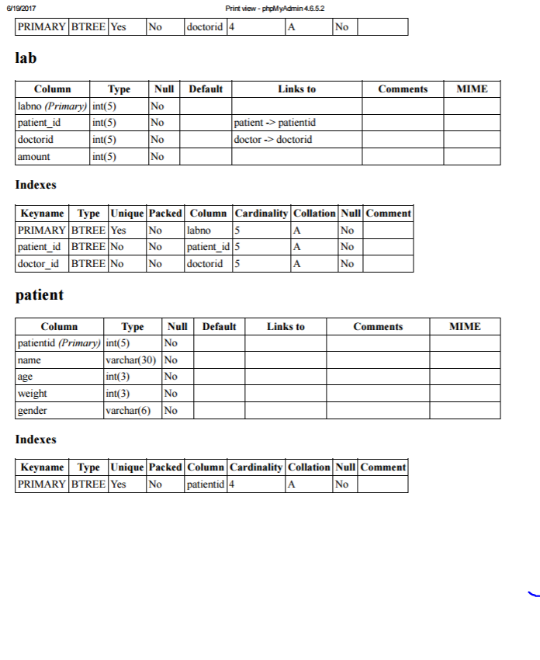
5.Data Dictionary

Slide 11
6. Script
DDL Statements:
-- phpMyAdmin SQL Dump
-- version 4.6.5.2
-- https://www.phpmyadmin.net
/---- Host: 127.0.0.1-- Generation Time: Jun 20, 2017 at 04:20 PM
-- Server version: 10.1.21
-MariaDB
-- PHP Version: 7.1.1SET SQL_MODE = "NO_AUTO_VALUE_ON_ZERO";SET time_zone = "+00:00";/*!40101 SET @OLD_CHARACTER_SET_CLIENT=@@CHARACTER_SET_CLIENT */;/*!40101 SET @OLD_CHARACTER_SET_RESULTS=@@CHARACTER_SET_RESULTS */;/*!40101 SET @OLD_COLLATION_CONNECTION=@@COLLATION_CONNECTION */;/*!40101 SET NAMES utf8mb4 */;
---- Database: `hospitaldatabase`----
---------------------------------------------------------
--- Table structure for table `appointmenttable`
--
CREATE TABLE `appointmenttable` ( `appointmentid` int(5) NOT NULL, `appointmentdate` date NOT NULL, `doctorid` int(5) NOT NULL, `patientid` int(5) NOT NULL) ENGINE=InnoDB DEFAULT CHARSET=latin1;----

Slide 12
6. Script
---- Table structure for table `bill`--
CREATE TABLE `bill` ( `billno` int(5) NOT NULL, `patientid` int(5) NOT NULL, `bill` int(10)
NOT NULL) ENGINE=InnoDB DEFAULT CHARSET=latin1;--
---- Table structure for table `doctor`--
CREATE TABLE `doctor` ( `doctorid` int(5) NOT NULL, `name` varchar(25) NOT NULL, `department`
varchar(20) NOT NULL, `email` varchar(35) NOT NULL, `gender` varchar(6) NOT NULL) ENGINE=InnoDB
DEFAULT CHARSET=latin1;
---- Table structure for table `lab`--
CREATE TABLE `lab` ( `labno` int(5) NOT NULL, `patient_id` int(5) NOT NULL, `doctorid` int(5) NOT NULL, `amount` int(5) NOT NULL) ENGINE=InnoDB DEFAULT CHARSET=latin1;
---- Table structure for table `patient`--
CREATE TABLE `patient` ( `patientid` int(5) NOT NULL, `name` varchar(30) NOT NULL, `age` int(3) NOT NULL, `weight` int(3) NOT NULL, `gender` varchar(6) NOT NULL) ENGINE=InnoDB DEFAULT CHARSET=latin1;

Slide 13
6. Script
---- Indexes for dumped tables---
--- Indexes for table `appointmenttable`--
ALTER TABLE `appointmenttable` ADD PRIMARY KEY (`appointmentid`),
ADD KEY `doctorid` (`doctorid`), ADD KEY `patientid` (`patientid`);--
-- Indexes for table `bill`--ALTER TABLE `bill` ADD PRIMARY KEY (`billno`),
ADD KEY `patientid` (`patientid`);
---- Indexes for table `doctor`--ALTER TABLE `doctor` ADD PRIMARY KEY (`doctorid`);
---- Indexes for table `lab`--ALTER TABLE `lab` ADD PRIMARY KEY (`labno`),
ADD KEY `patient_id` (`patient_id`), ADD KEY `doctor_id` (`doctorid`);-
--- Indexes for table `patient`--
ALTER TABLE `patient` ADD PRIMARY KEY (`patientid`);-
--- Constraints for dumped tables-
----- Constraints for table `appointmenttable`
--ALTER TABLE `appointmenttable` ADD CONSTRAINT `appointmenttable_ibfk_1` FOREIGN KEY (`doctorid`) REFERENCES `doctor` (`doctorid`), ADD CONSTRAINT `appointmenttable_ibfk_2` FOREIGN KEY (`patientid`) REFERENCES `patient` (`patientid`);----

Slide 14
6. Script
Constraints for table `bill`--
ALTER TABLE `bill` ADD CONSTRAINT `patientid` FOREIGN KEY (`patientid`) REFERENCES `patient` (`patientid`) ON DELETE CASCADE ON UPDATE CASCADE;
---- Constraints for table `lab`--
ALTER TABLE `lab` ADD CONSTRAINT `doctor_id` FOREIGN KEY (`doctorid`) REFERENCES `doctor` (`doctorid`) ON DELETE CASCADE ON UPDATE CASCADE, ADD CONSTRAINT `patient_id` FOREIGN KEY (`patient_id`) REFERENCES `patient` (`patientid`) ON DELETE CASCADE ON UPDATE CASCADE;
/*!40101 SET CHARACTER_SET_CLIENT=@OLD_CHARACTER_SET_CLIENT */;/*!40101 SET CHARACTER_SET_RESULTS=@OLD_CHARACTER_SET_RESULTS */;/*!40101 SET COLLATION_CONNECTION=@OLD_COLLATION_CONNECTION */;
Insert Into Tables
-- Dumping data for table `appointmenttable`
--INSERT INTO `appointmenttable` (`appointmentid`, `appointmentdate`, `doctorid`, `patientid`) VALUES(401, '2017-06-11', 201, 101),(403, '2017-06-22', 201, 103),(404, '2017-06-24', 203, 101),(405, '2017-06-16', 203, 102);
-- --------------------------------------------------------

Slide 15
6. Script
---- Dumping data for table `bill`--
INSERT INTO `bill` (`billno`, `patientid`, `bill`) VALUES(501, 101, 100),(502, 102, 200),(503, 102, 200),(504, 104, 100),(505, 104, 100);
-- --------------------------------------------------------
---- Dumping data for table `doctor`--
INSERT INTO `doctor` (`doctorid`, `name`, `department`, `email`, `gender`) VALUES
(201, 'naga praneeth', 'eye', 'praneeth@gmail.com', 'male'),
(202, 'bushan', 'skin', 'bushan@gmail.com', 'male'),
(203, 'srikar', 'cardiologist', 'srikar@gmail.com', 'male'),
(204, 'naga', 'Anesthesiologist', 'naga@gmail.com', 'male'),
(205, 'siva', 'psychiatrist', 'siva@gmail.com', 'male');

Slide 16
6. Script
-- Dumping data for table `lab`--INSERT INTO `lab`
(`labno`, `patient_id`, `doctorid`, `amount`) VALUES
(301, 101, 201, 100),
(302, 102, 202, 200),
(303, 103, 203, 50),
(304, 102, 202, 30),
(305, 101, 204, 50);
---- Dumping data for table `patient`--
INSERT INTO `patient` (`patientid`, `name`, `age`, `weight`, `gender`) VALUES
(101, 'naga praneeth', 22, 170, 'male'),
(102, 'bushan', 28, 170, 'male'),
(103, 'srikar', 23, 160, 'male'),
(104, 'naga', 23, 169, 'male'),
(105, 'siva', 28, 175, 'male');

Slide 17
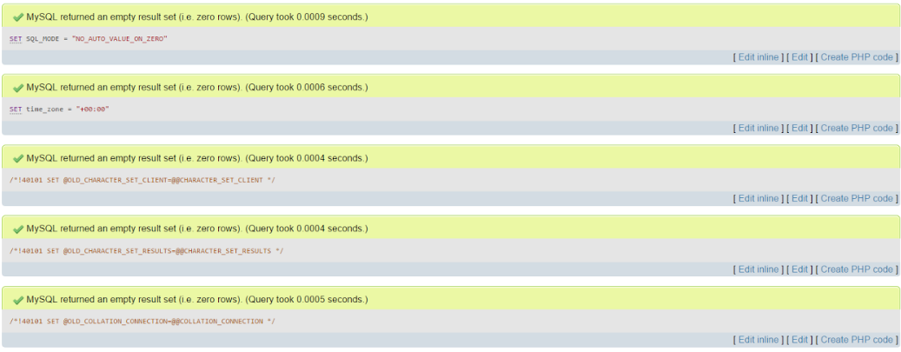
7. Run your Script

Slide 18
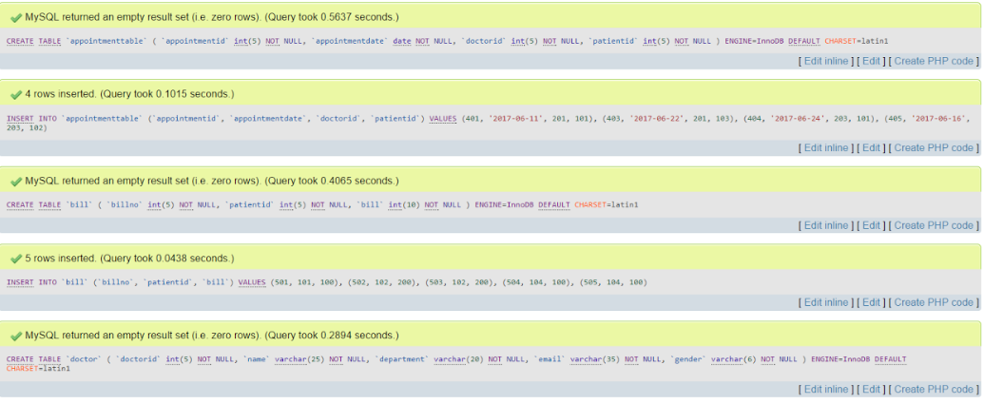
7. Run your Script(Contd1)

Slide 19
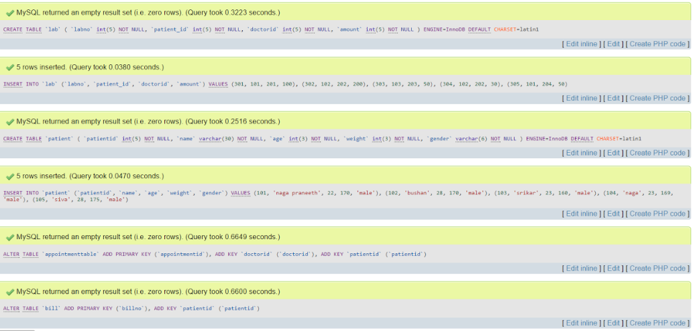
7. Run your Script(Contd2)

Slide 20
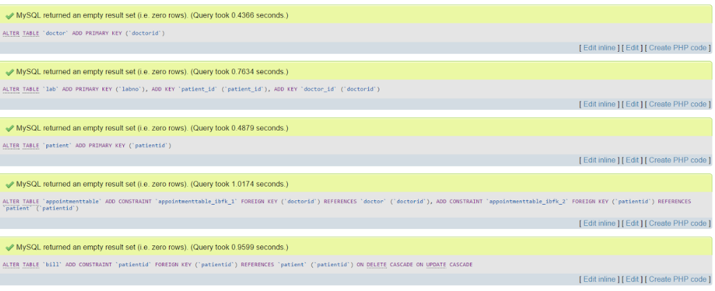
7. Run your Script(Contd3)

Slide 21
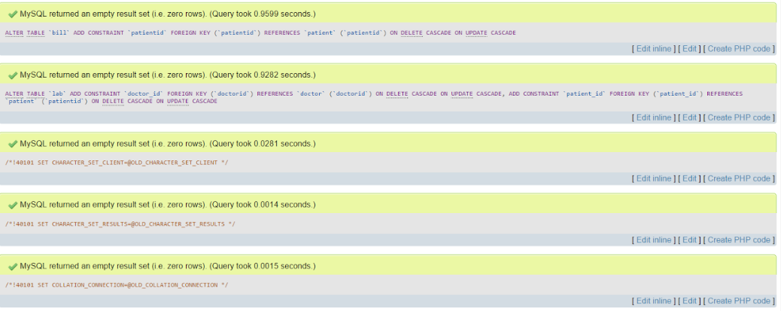
7. Run your Script(Contd4)

Slide 22
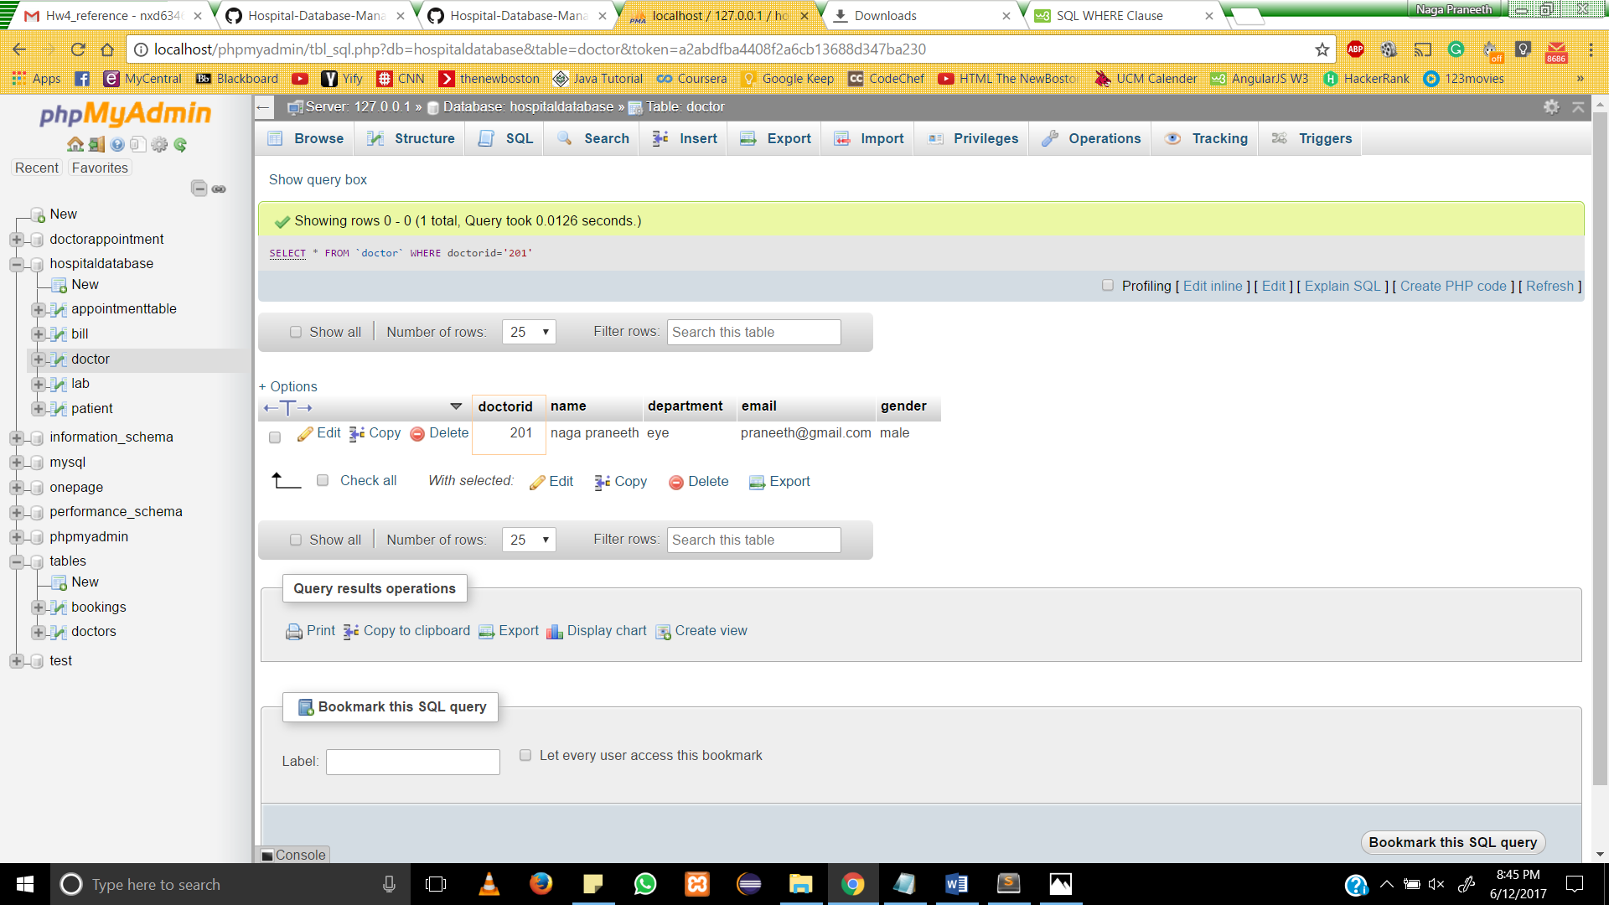
8. 5 Different Type of Queries(1)
Query 1: Get the information of the Doctor from Doctor table whose Doctor Id=‘201’

Slide 23
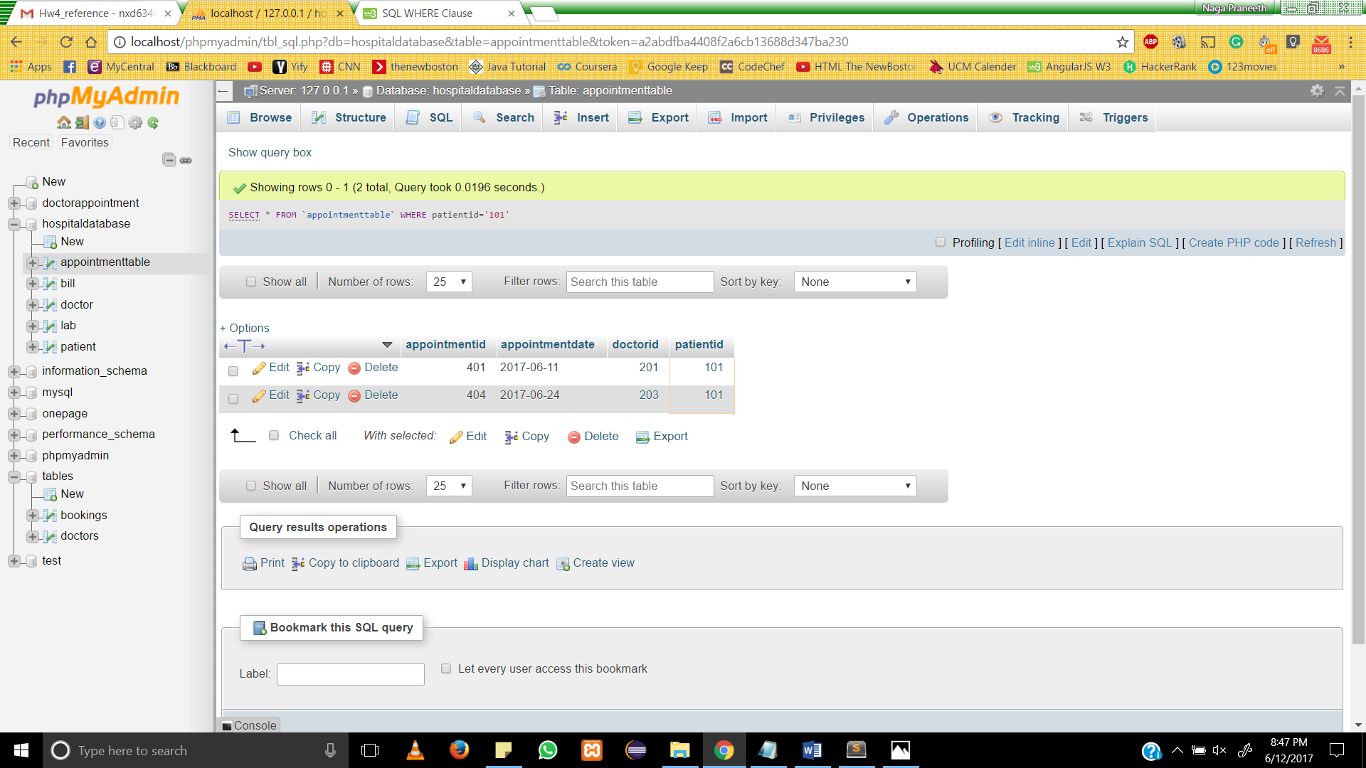
8. 5 Different Type of Queries(2)
Query 2: Get the information of the Patient whose Patient Id=‘101’

Slide 24
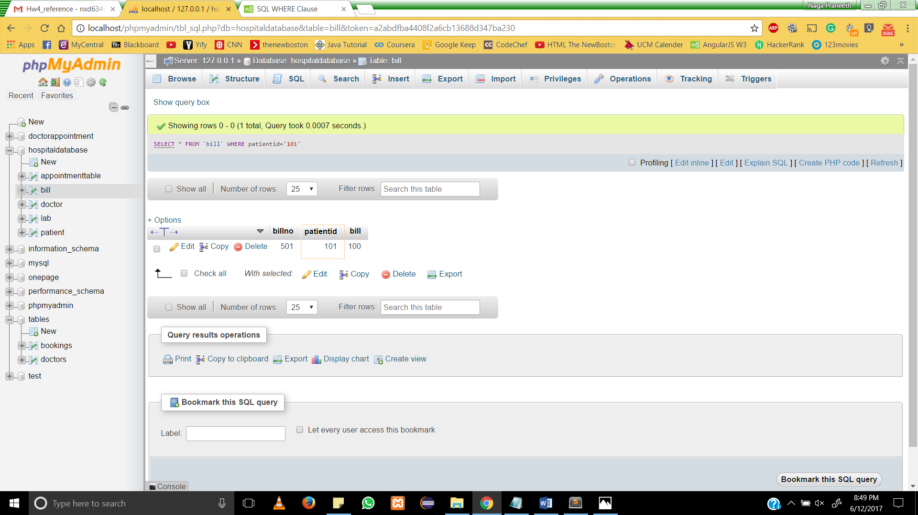
8. 5 Different Type of Queries(3)
Query 2: Get the information of the bill where Patient Id=‘101’

Slide 25

8. 5 Different Type of Queries(4)
Query 2: Get the information from the lab where amount=‘50’;

Slide 26
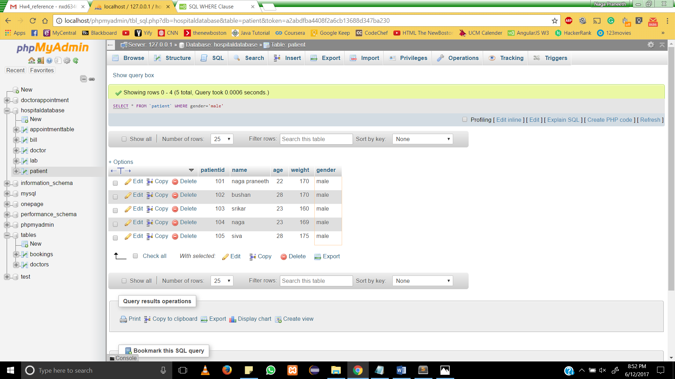
8. 5 Different Type of Queries(5) Query 2: Get the information from the patient where gender=‘male’;

Slide 27
9. Conclusion
The database takes care of all the requirements and is capable to provide easy and effective storage of information related to patients who come up to the hospital.
Generates test reports .
Provides billing facility.
There were some issues when trying to add constraints such as establishing foreign key between the tables, we have done research at few websites and resolved the issues.
We are able to create an Database, ER diagrams, Relational model and understand Data dictionary.

Slide 28
9. References
IOSR Journal of Mobile Computing & Application (IOSR-JMCA) e-ISSN: 2394-0050, P-ISSN: 2394-0042.Volume 2, Issue 1. (Mar. - Apr. 2015), PP 32-36 www.iosrjournals.org
Praveen K.A and Gomes L.A, 2006: “A Study of the Hospital Information System (HIS) In the Medical Records Department of A Tertiary Teaching Hospital” Journal of the Academy of Hospital Administration, Vol. 18, No. 1 (2006-01 - 2006-12).
Hospital Management Information System, Gujarat Informatics System (2012)

